Slide 1
Discourse Analysis
Dr. S. Joseph Arul Jayraj
Head & Associate Professor of English
St. Joseph’s College (Autonomous)
Tiruchirappalli-620002.

Slide 2
What is a discourse? written or spoken discussion, conversation, talk, dialogue, communication, conference, debate, consultation, etc.

Slide 3
5 Types of Discourse
Narration
Description
Argumentation
Exposition

Slide 4
What is discourse analysis?
(1) the study of the ways in which language is used in texts and contexts.

Slide 5
(2) It includes applied linguistics, conversation analysis, rhetoric, stylistics, pragmatics, and text linguistics.
(3) The study of how meanings are established, used, challenged and changed (including in talk).

Slide 6
Why to analyse discourse? i. To understand ourselves within our social worlds and their complexity or to know about people and their social worlds. ii. To understand the varied possibilities and implications of certain meanings and world views. iii. It is interesting.

Slide 7
What kinds of data? a. Language data (written/spoken) is collected. b. Other kinds of evidences collected: (image of the Holy Spirit─Why Pigeon & not Crow?), behaviours (Judas kissing Jesus), situations– found)

Slide 8
Chomsky (1980) ‘Discourse competence’ is part of ‘Linguistic competence’.
.Single sentences: contrived (forced) by the linguist (′GEORGE likes fish, George ′LIKES fish, George likes ′FISH), within the context.
.Out of context (“Is there a text in this class?”).

Slide 9
In Traditional Literature, context creates content; in Absurd Drama, content creates context (Waiting for Godot)

Slide 10
Syntactical/Structural Analysis

Slide 11
e.g. “The lady kissed the man with spectacles”.
. The phrase “with spectacles” is the cause for ambiguity -- syntax or structure.
. It is not clear whether the lady is using spectacles to kiss a man or she kisses a man who is wearing spectacles or the lady who is wearing spectacles kisses the man.

Slide 12
TWO SOVIET SHIPS COLLIDE, ONE DIES

Slide 13
ENRAGED COW INJURES FARMER WITH AX

Slide 14
DEALERS WILL HEAR CAR TALK AT NOON

Slide 15
Semantic Analysis

Slide 16
The best way to lie is to tell the truth . . . carefully edited truth.
ANONYMOUS

Slide 17
Going to church doesn’t make you a Christian any more than standing in a garage makes you a car.
BILLY SUNDAY

Slide 18
If you steal from one author, it’s plagiarism; if you steal from many, it’s research.
WILSON MIZNER

Slide 19
You spend the first 2 years of Children’s life teaching them to walk and talk. Then you spend the next 16 telling them to sit down and shut-up.
ANONYMOUS

Slide 20
Women who seek to be equal with men lack ambition.
MARILYN MANROE

Slide 21
To err is human, to blame it on somebody else shows management potential.
ANONYMOUS

Slide 22
Before I got married, I had six theories about bringing up children; now I have six children and no theories.
JOHN WILMOT

Slide 23
An archaeologist is the best husband a woman can have; the older she gets the more interested he is in her.
AGATHA CHRISTIE

Slide 24
Politicians and diapers have one thing in common. They should both be changed regularly, and for the same reason.
ANONYMOUS

Slide 25
At every party, there are two kinds of people–those who want to go home and those who don’t. The trouble is, they are usually married to each other.
ANN LANDERS

Slide 26
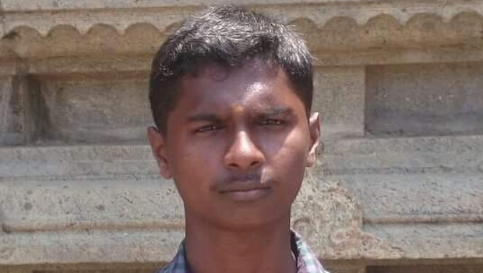


Slide 27
. Example, “I love you”.
.It is a fragment.
.The structure of the text reveals one’s repressed desires.

Slide 28
b. It brings forth the opposition between ‘wish’ & ‘power’. c. Uttered by a person who tries to impose his ‘wish’/‘will’ over the other person fulfilling the satisfaction of his/her repressed desires in convincing the other person.

Slide 29
d. Polarities of ‘I’ and ‘you’:
The ‘I’ in the UPPER CASE and the ‘you’ in the lower case denote that the ‘I’ is much bigger, much more important, and much more power- driven than ‘you’.

Slide 30
e. The ‘I’ is the activator of love and the ‘you’ is the passive receptor, who has no chance of rejecting or negating the proposal in this power game.

Slide 31
f. Not naturally produced, proposed & conveyed but it is posited (assumed) by an arbitrary act of language which is taken for granted.

Slide 32
g. Self-reflexive love where the ‘I’ is forefronted in the background of the ‘you’ fulfilling the desires of ‘I’. h. ‘I’ uses the ‘you’ to fulfil its repressed desires under the camouflage of ‘so-called’ love.

Slide 33
i. The love ‘I’ has is narcissistic and so it is not ‘love’ which it has for the ‘you’ . j. This ‘love’ is ‘non-love’, ‘defective love’ assigns chiefly a negative value in relation to the ‘I’.

Slide 34
k. ‘I’ is not inclusive but exclusive of ‘you’. l. The real meaning of ‘I love you’ is not the love the ‘I’ has for ‘you’, but it is ‘I’ love ‘I’ (the love the ‘I’ has for ‘I’).

Slide 35
m. Self-love culminates to the realization that the ‘I’ has something other than ‘love’ for ‘you’. n. In some extreme situation (in the case of rape), it turns out to be ‘hatred’ for the ‘you’ as soon as the repressed desires of the ‘I’ are fulfilled by the ‘you’.

Slide 36
Criticism on discourse analytic research: i. Deterministic? (No, it is about how meanings are used and contested.) ii. Just words? (Not just words, but arrangement of word(s) in a discourse material.)

Slide 37
Zelling Harris Discourse (1952) is ‘a combination of sentences’.
Example,
Dialogue:
Principal: What does he look like? Stupid? or Intelligent?
PA: Fairly intelligent I’d say, Sir.
Principal: Good! Then he is not a member of NAAC. Show him in.

Slide 38
Text=‘verbal record of a communicative act’ (product).
Discourse=‘the dynamic process of creating the text’ (process).
In Discourse analysis, meaning is not seen as a static, abstract notion attached to words or sentences, but a ‘dynamic interactive force’ constructed by the mind from language in context.

Slide 39
Harold Bloom: “There are no texts, but only interpretations”.
So, a text is foregrounded in the background of context because words cannot interpret themselves. They can be interpreted only in contexts.

Slide 40
Try to Interpret the Following Poem:
I smoke, you don’t;
I smoke, you don’t;
I smoke, you don’t; u between s, only ashes and smoke!

Slide 41


